Slide 1


A Terragni
Case Study
Driving Customer Engagement for Affluent Banking
TERRAGNI CONSULTING (P) LTD PRIVATE AND CONFIDENTIAL

Slide 2

Client Background
Objective
Challenge
Behaviour Shifts
Friction
Motivation
Sensemaking
Context
Solutions
Implementation
Business Outcomes
Samples
2nd
1600
15,00,000
Largest private bank in India
Branches
Customers Pan India
TERRAGNI CONSULTING (P) LTD PRIVATE AND CONFIDENTIAL

Slide 3

Client Background
Objective
Challenge
Behaviour Shifts
Friction
Motivation
Sensemaking
Context
Solutions
Implementation
Business Outcomes
Samples
Objective
Strategic Outcomes
Increasing monetization of the affluent
and HNI program.
TERRAGNI CONSULTING (P) LTD PRIVATE AND CONFIDENTIAL

Slide 4

Client Background
Objective
Challenge
Behaviour Shifts
Friction
Motivation
Sensemaking
Context
Solutions
Implementation
Business Outcomes
Samples
Business outcomes require behaviour shifts
Higher program utilization by existing customers
Higher word-of-mouth (to influence potential customers)
TERRAGNI CONSULTING (P) LTD PRIVATE AND CONFIDENTIAL

Slide 5



Client Background
Objective
Challenge
Behaviour Shifts
Friction
Motivation
Sensemaking
Context
Solutions
Implementation
Business Outcomes
Samples
Behaviour shifts require an understanding of:
Friction: Barriers that will prevent program utilization and word of mouth
Motivation: What will drive higher program utilization and word of mouth
Context: the who, what, how, when and why
TERRAGNI CONSULTING (P) LTD PRIVATE AND CONFIDENTIAL

Slide 6



Client Background
Objective
Challenge
Behaviour Shifts
Friction
Motivation
Sensemaking
Context
Solutions
Implementation
Business Outcomes
Samples
^{Friction}
Barriers that will prevent program utilization and word of mouth
Behaviour Shifts for Program Utilization and Word-of-Mouth
^{Motivation}
What will drive higher program utilization and word of mouth
^{Context}
The who, what, how, when and why to identify friction and motivation
TERRAGNI CONSULTING (P) LTD PRIVATE AND CONFIDENTIAL

Slide 7
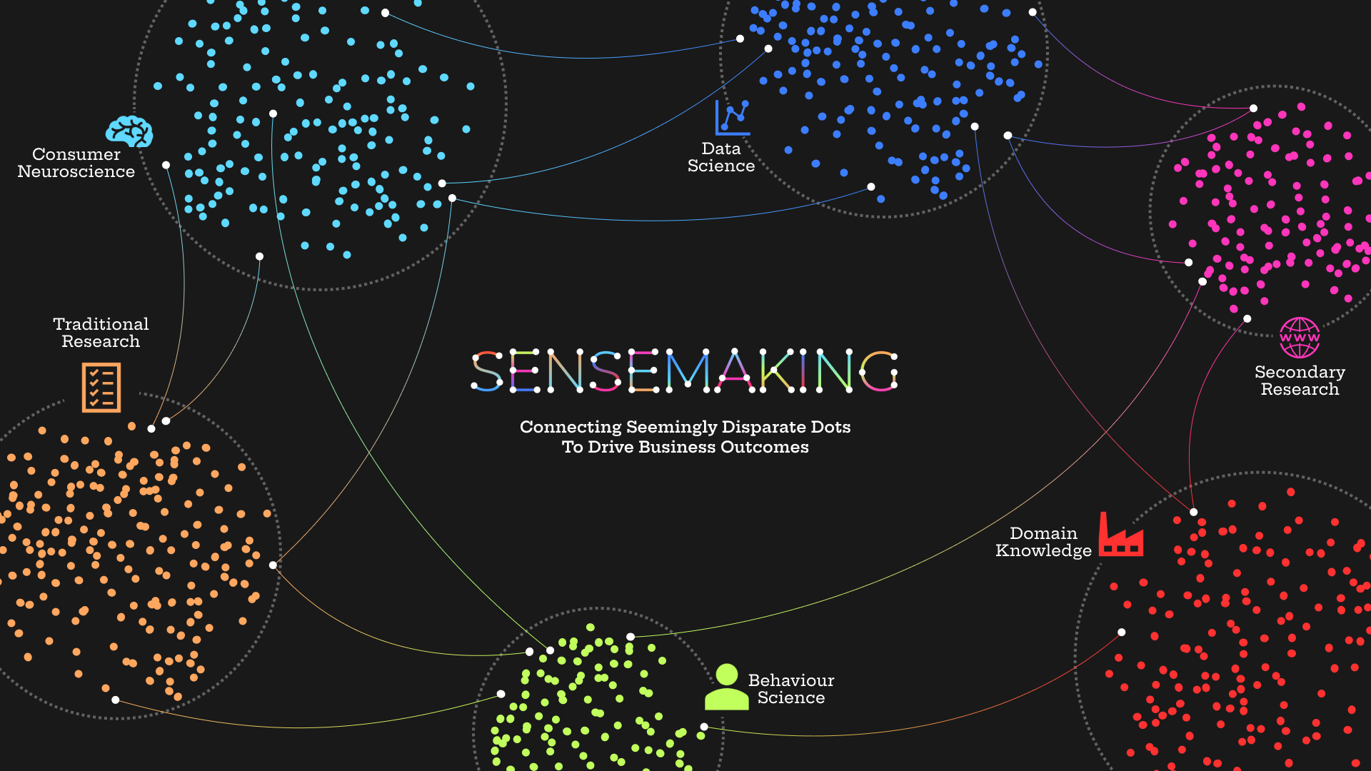
TERRAGNI CONSULTING (P) LTD PRIVATE AND CONFIDENTIAL | NOT TO BE CIRCULATED WITHOUT PRIOR AUTHORIZATION

Slide 8
Client Background
Objective
Challenge
Behaviour Shifts
Friction
Motivation
Sensemaking
Context
Solutions
Implementation
Business Outcomes
Samples
Friction
Friction for customers:
A breakdown on the basic expectation of friction free financial transactions disengages the customer from the entire program.
Sludge in the organization:
“Relationship Manager” was not effective either in support or service recovery
TERRAGNI CONSULTING (P) LTD PRIVATE AND CONFIDENTIAL

Slide 9
Client Background
Objective
Challenge
Behaviour Shifts
Friction
Motivation
Sensemaking
Context
Solutions
Implementation
Business Outcomes
Samples
Motivation
Align offerings based on context of the customers
Meeting the hierarchy of expectations:
Financial transactions - safe, secure and friction free
Help in wealth management - contextual. consistent. transparent
Enhance their lifestyle - personalized prestige. personalized convenience
TERRAGNI CONSULTING (P) LTD PRIVATE AND CONFIDENTIAL

Slide 10
Client Background
Objective
Challenge
Behaviour Shifts
Friction
Motivation
Sensemaking
Context
Solutions
Implementation
Business Outcomes
Samples
Context
Lens through which customers view the engagement.
Multilayered expectations of affluent and HNI customers:
Functional Needs
Friction-free transactions and basic banking
Prestige & Emotional Salience
Exclusivity, Preferential Banking, Personalized Convenience, Aspiration
TERRAGNI CONSULTING (P) LTD PRIVATE AND CONFIDENTIAL

Slide 11
Client Background
Objective
Challenge
Behaviour Shifts
Friction
Motivation
Sensemaking
Context
Solutions
Implementation
Business Outcomes
Samples
Context
Lens through which customers view the engagement.
Experiential Segments
Differentiated needs, emotions and expectations led to creating segments based on desired experiences.
Resulting in offerings & experiences that closely match customer context, to stay continuously relevant
TERRAGNI CONSULTING (P) LTD PRIVATE AND CONFIDENTIAL

Slide 12





Client Background
Objective
Challenge
Behaviour Shifts
Friction
Motivation
Sensemaking
Context
Solutions
Implementation
Business Outcomes
Samples
RELATIONSHIP CUSTODIAN
THE WHITE GLOVE
SERVICE RECOVERY
EXPERIENTIAL SEGMENTS
Generating trust & alignment with the customer aspirations & challenges
Making the customer feel “Prioritized” & “Differentiated”
Driving “Exclusivity”, “Affiliation” and “Prestige”
Conveying assurance - when things go wrong, customer will face the least stress & impact
Designing offerings & experiences that closely match customer context, to stay continuously relevant
TERRAGNI CONSULTING (P) LTD PRIVATE AND CONFIDENTIAL

Slide 13

Client Background
Objective
Challenge
Behaviour Shifts
Friction
Motivation
Sensemaking
Context
Solutions
Implementation
Business Outcomes
Samples
CONTEXT
From inside out to outside in
Experiential segmentation
Friction and motivation are different for different segments. Experiential segments are based on the context and desired outcomes of the customers.
TERRAGNI CONSULTING (P) LTD PRIVATE AND CONFIDENTIAL

Slide 14
Client Background
Objective
Challenge
Behaviour Shifts
Friction
Motivation
Sensemaking
Context
Solutions
Implementation
Business Outcomes
Samples
Experiential segmentation
5 different experiential segments. The offerings have the potential to be positioned according to the experiences they can lead to, rather than by their features, performance attributes or functional benefits
⭐Self Made Tycoon
⭐Mature Professionals
⭐PSB Migrant
⭐Steel Grey
⭐Emerging Professionals
TERRAGNI CONSULTING (P) LTD PRIVATE AND CONFIDENTIAL

Slide 15

Client Background
Objective
Challenge
Behaviour Shifts
Friction
Motivation
Sensemaking
Context
Solutions
Implementation
Business Outcomes
Samples
CONTEXT
From inside out to outside in
White-Glove
A concierge program that continually aligns to customers’ functional & emotional context & experiential expectations
TERRAGNI CONSULTING (P) LTD PRIVATE AND CONFIDENTIAL

Slide 16
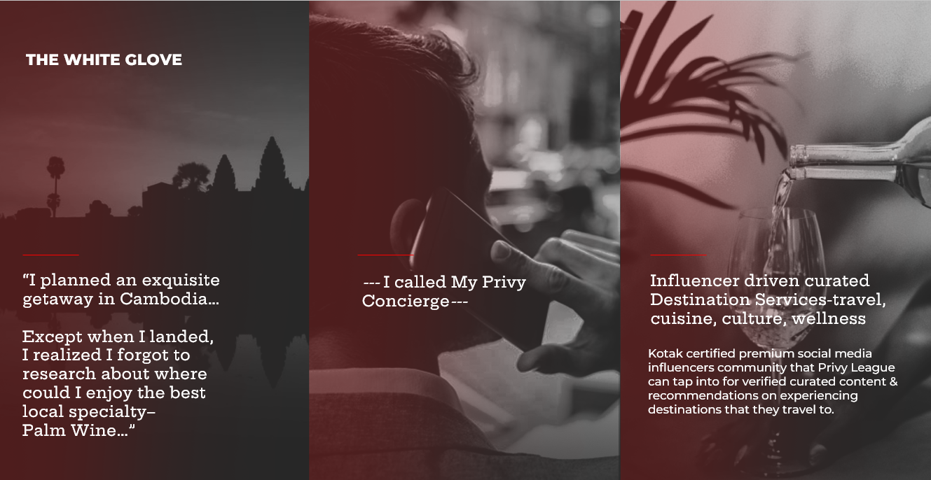
Client Background
Objective
Challenge
Behaviour Shifts
Friction
Motivation
Sensemaking
Context
Solutions
Implementation
Business Outcomes
Samples
TERRAGNI CONSULTING (P) LTD PRIVATE AND CONFIDENTIAL

Slide 17

Client Background
Objective
Challenge
Behaviour Shifts
Friction
Motivation
Sensemaking
Context
Solutions
Implementation
Business Outcomes
Samples
MOTIVATION
Meeting the Hierarchy of Expectations
Relationship Custodian
RM to have expertise in banking, industry insights, wealth and legacy planning to support in meeting functional needs
To build rapport, provide updates and have frequent connect on topics of interest to the customers to build engagement and meet emotional needs
Building a seamless digital-physical handshake to eliminate friction in digital channels
TERRAGNI CONSULTING (P) LTD PRIVATE AND CONFIDENTIAL

Slide 18

Client Background
Objective
Challenge
Behaviour Shifts
Friction
Motivation
Sensemaking
Context
Solutions
Implementation
Business Outcomes
Samples
FRICTION
Cognitive and Temporal
Service Recovery
Immediate Response: Established escalation matrix with no questions asked redressal
Short-Term Response: Best resolution to address functional needs with proactive and timebound updates
Process Shifts: System changes, Process alignments, People Orientation
TERRAGNI CONSULTING (P) LTD PRIVATE AND CONFIDENTIAL

Slide 19
Client Background
Objective
Challenge
Behaviour Shifts
Friction
Motivation
Sensemaking
Context
Solutions
Implementation
Business Outcomes
Samples
FRICTION
Perceived
Eliminating perceived friction
behaviour science-led communication
Communication to provide clarity and evoke “the future state” for each segment
Using behaviour science principles to design artefacts that communicate exclusivity, personalized prestige, convenience and aspiration
TERRAGNI CONSULTING (P) LTD PRIVATE AND CONFIDENTIAL

Slide 20
Client Background
Objective
Challenge
Behaviour Shifts
Friction
Motivation
Sensemaking
Context
Solutions
Implementation
Business Outcomes
Samples
Implementation Support | 90-120 days
EXPERIENTIAL SEGMENTS
RELATIONSHIP CUSTODIAN
Preliminary classification –
Persona based
Operational fixes guided by the Experience Grids for each segment
Friction as a KPI
Identifying segment-wise differential journeys for each segment, based on the experience grid
Awareness building program of relevant benefits
Design & implement “Senior” Person connect program
Systemic insights program for utilization levels
Designing the “EXPERTISE” centre – structure, people, processes
THE WHITE GLOVE
SERVICE RECOVERY
Prioritizing “White Glove” areas
Identifying alliances and partnerships
Designing differentiated communication & messaging based on segments & utilization insights
Closure of open issues – resolve or conclude
Escalation matrix –
Create, publish, popularize & demonstrate
Identifying key service recovery journeys based on insights from past service & support data
TERRAGNI CONSULTING (P) LTD PRIVATE AND CONFIDENTIAL

Slide 21

Client Background
Objective
Challenge
Behaviour Shifts
Friction
Motivation
Sensemaking
Context
Solutions
Implementation
Business Outcomes
Samples
⬆ Increased Wallet Share
⬆Increased Customer Acquisition through recommendation
⬆Increased Customer Retention
TERRAGNI CONSULTING (P) LTD PRIVATE AND CONFIDENTIAL

Slide 22
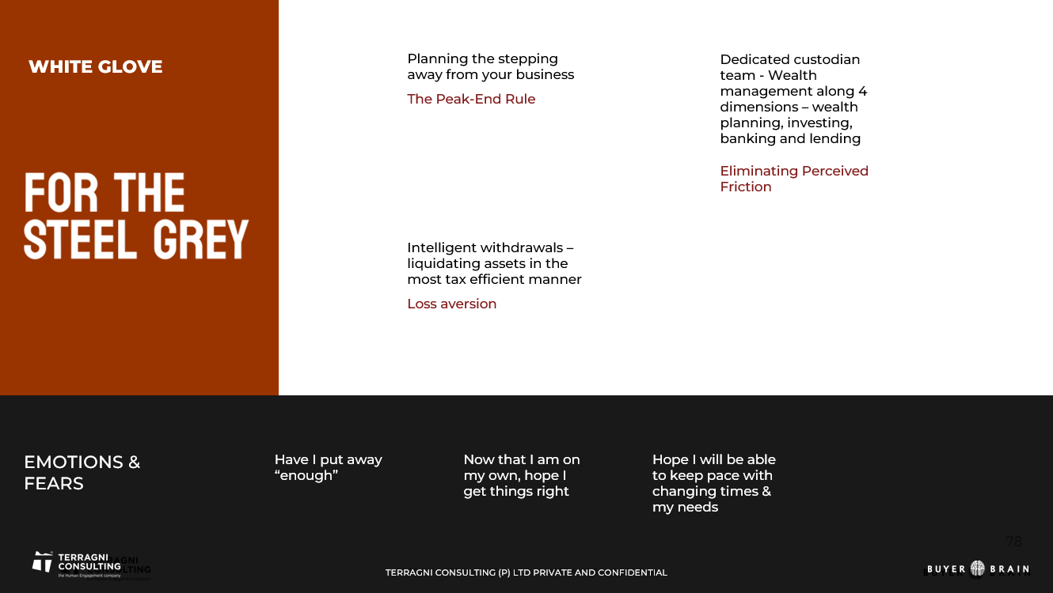
Client Background
Objective
Challenge
Behaviour Shifts
Friction
Motivation
Sensemaking
Context
Segmentation
Solutions
Implementation
Business Outcomes
Samples
Sample
TERRAGNI CONSULTING (P) LTD PRIVATE AND CONFIDENTIAL

Slide 23
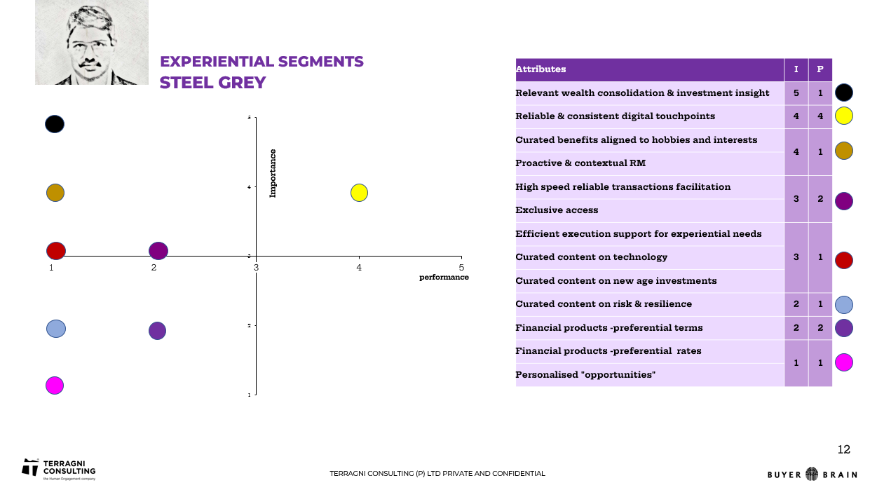
Sample
Client Background
Objective
Challenge
Behaviour Shifts
Friction
Motivation
Sensemaking
Context
Segmentation
Solutions
Implementation
Business Outcomes
Samples
TERRAGNI CONSULTING (P) LTD PRIVATE AND CONFIDENTIAL

Slide 24
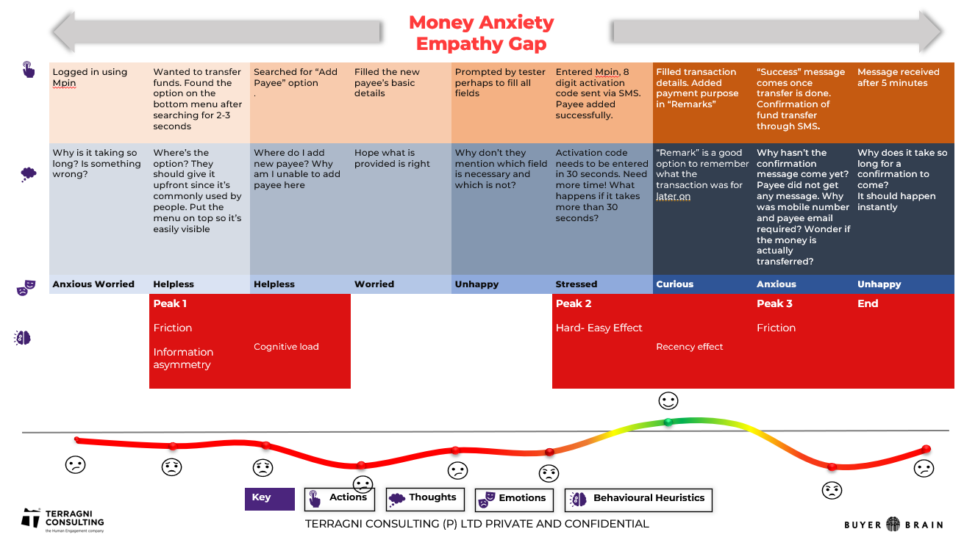
Sample
Client Background
Objective
Challenge
Behaviour Shifts
Friction
Motivation
Sensemaking
Context
Segmentation
Solutions
Implementation
Business Outcomes
Samples
TERRAGNI CONSULTING (P) LTD PRIVATE AND CONFIDENTIAL

Slide 25
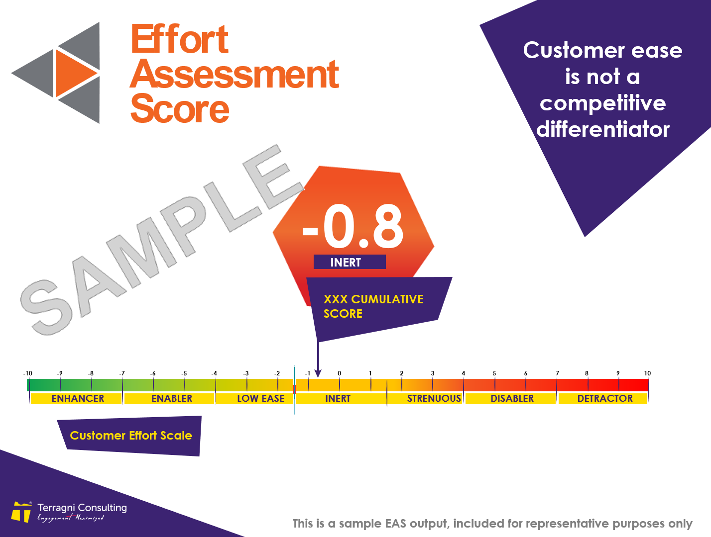
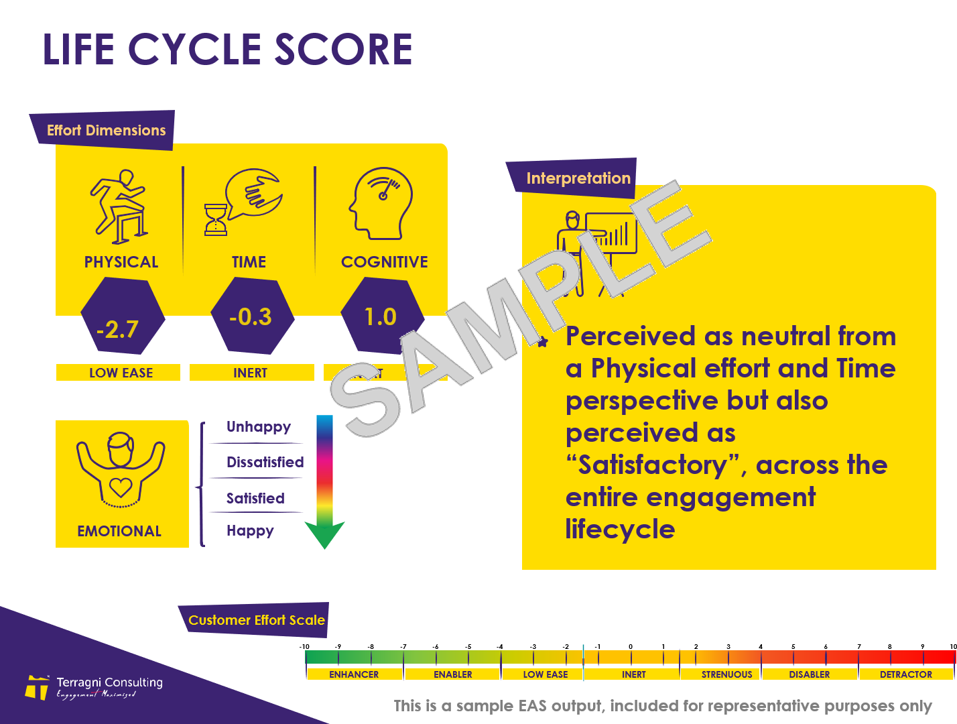
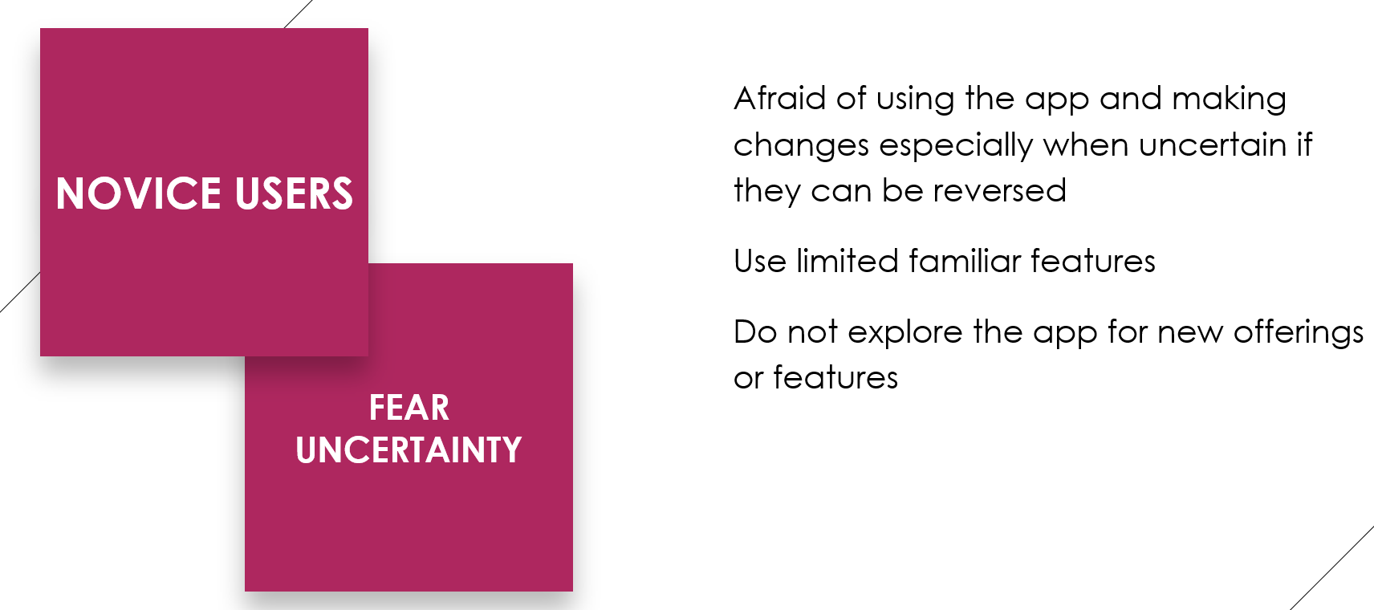
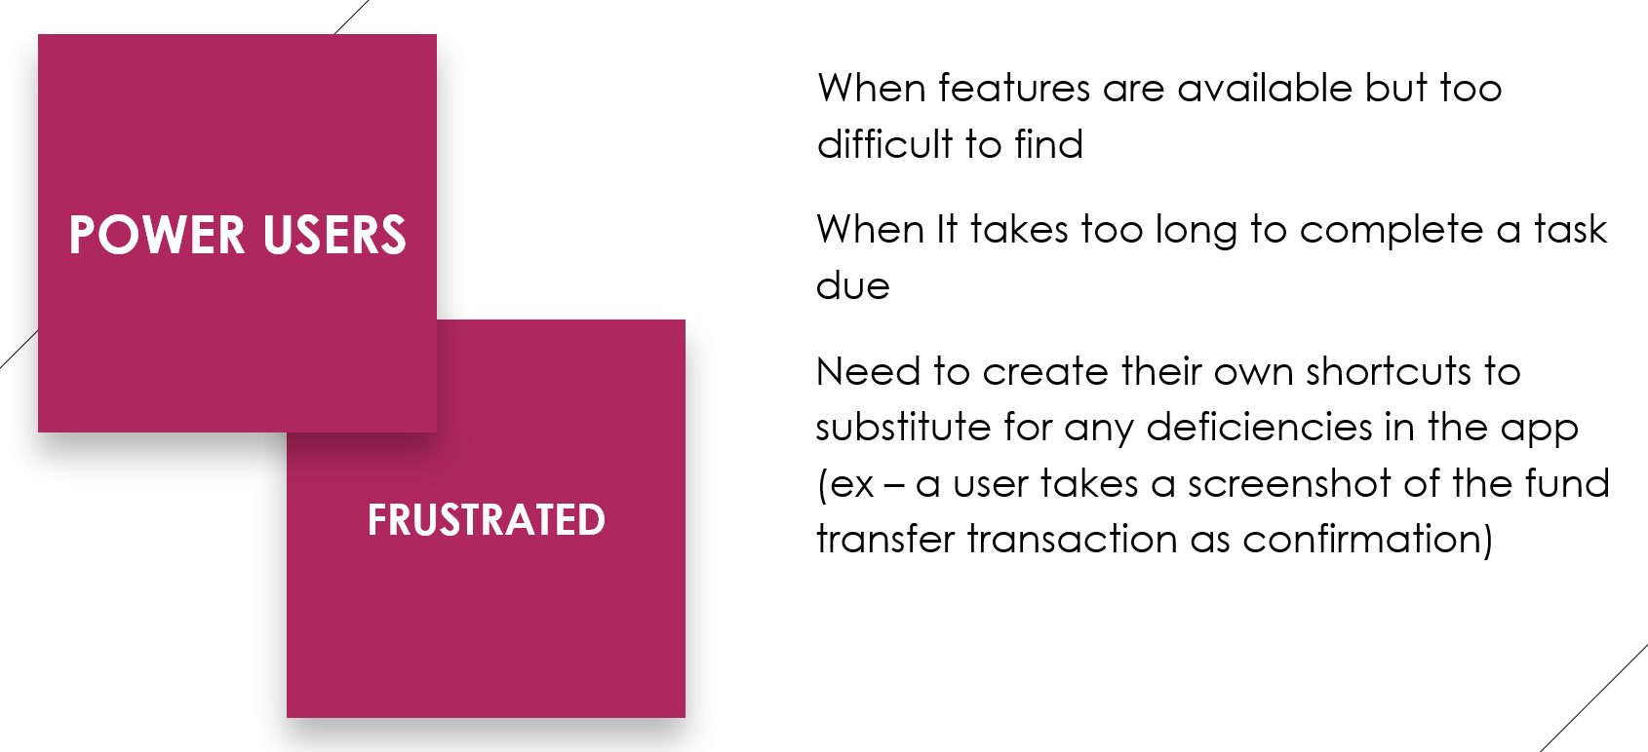
Sample
Client Background
Objective
Challenge
Behaviour Shifts
Friction
Motivation
Sensemaking
Context
Segmentation
Solutions
Implementation
Business Outcomes
Samples
SAMPLE
TERRAGNI CONSULTING (P) LTD PRIVATE AND CONFIDENTIAL

Slide 26
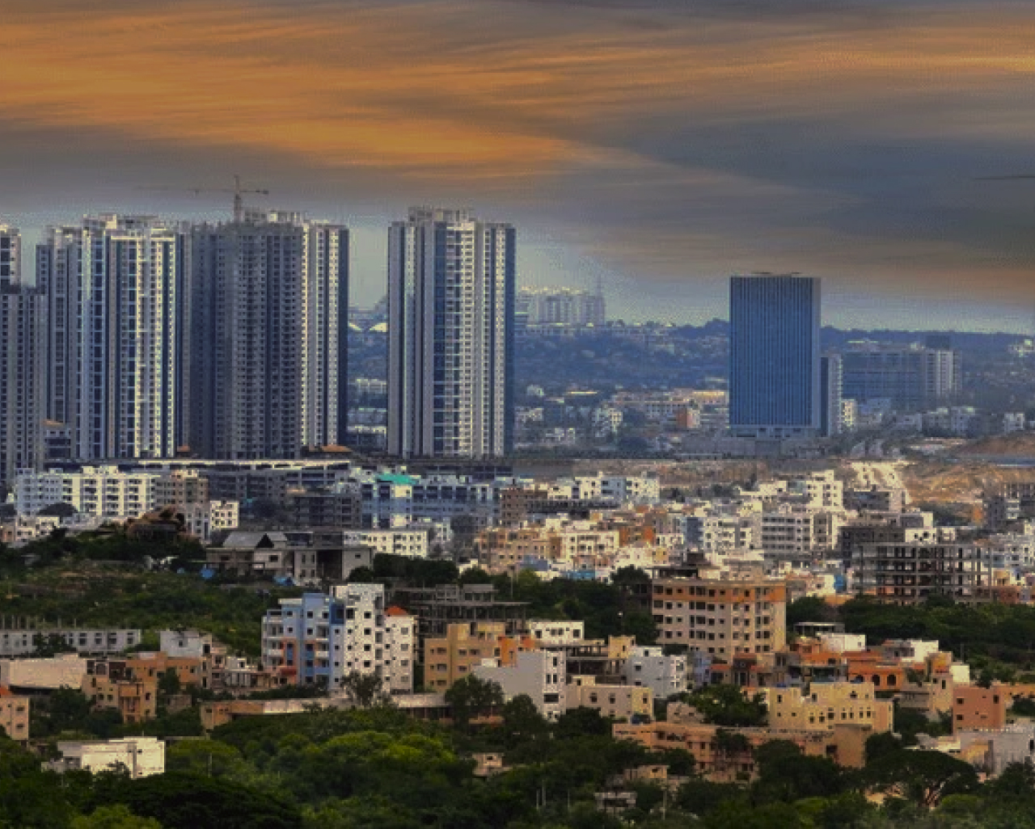


India
London
Bucharest
www.terragni.in
www.buyerbrain.com

Slide 27
dipti@terragni.in
+91 89569 82522
Thank You

